Slide 1
UVa 10689 Yet another Number Sequence

Slide 2
UVa 10689 Yet another Number Sequence (Time Limit: 3 seconds)
數字序列:讓我們根據以下的函數來定義一種數列：
f(0)=a
f(1)=b
f(n)=f(n-1)+f(n-2), n>1
當 a=0 , b=1 時，這數列就是費伯那西數列（Fibonacci Sequence）。若改變 a 和 b 的值，你會得到許多不同的數列。在這個問題中，給你 a,b 的值，請你找出 f(n) 的最右邊m位數字。例如：a=0, b=1, f(12)=144，所以若 m=3，則答案是144。若 m=2，則答案是44。若 m=1，則答案是4。
(0≦a, b≦100, 0≦n≦1000000000, 1≦m≦4)

Slide 3
Example:
f(0)=a
f(1)=b
f(n)=f(n-1)+f(n-2), n>1
a=0 b=1
Fibonacci Sequence
0 | 1 | 2 | 3 | 4 | 5 | 6 | 7 | 8 | 9 | 10 | 11
0 | 1 | 1 | 2 | 3 | 5 | 8 | 13 | 21 | 34 | 55 | 89
12 | 13 | 14 | 15 | 16 | 17 | 18 | 19 | 20 | 21 | 22 | 23
144 | 233 | 377 | 610 | 987 | 1597 | 2584 | 4181 | 6765 | 10946 | 17711 | 28657
Test Case #1
a=0 b=1 n=11 m=3
f(11)=89
Output: 89
Test Case #3
a=0 b=1 n=22 m=4
f(22)=17711
Output: 7711
Test Case #4
a=0 b=1 n=21 m=4
f(21)=10946
Output: 946
輸出f(n)最右邊m位數字

Slide 4
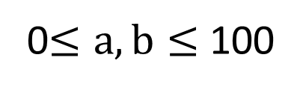
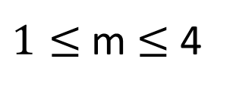
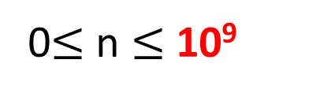
Sample Input
4
0 1 11 3
0 1 42 4
0 1 22 4
0 1 21 4
Sample Output
Test Case數目
Test Case #1
89
4296
7711
946
a, b, n, m
Test Case #2
Test Case #3
Test Case #4
f(0)=a
f(1)=b
f(n)=f(n-1)+f(n-2), n>1
0$≤a,b≤$100
0$≤$n $≤$10⁹
$1≤$m $≤$4
輸出f(n)最右邊m位數字

Slide 5
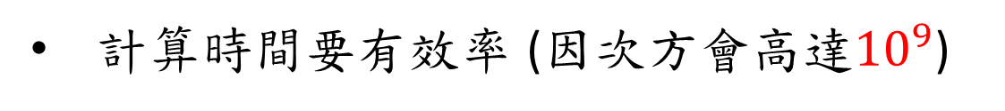
Solution
將數列問題轉化為矩陣高次方求值的問題
計算時間要有效率 (因次方會高達${10}^{9}$)
採用recursive squaring method
要避免integer overflow
善用mod計算
因為要輸出尾端m位數字

Slide 6
推演過程

Slide 7
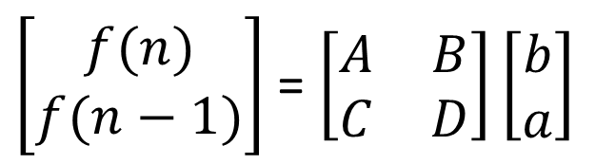
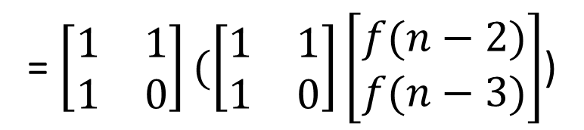
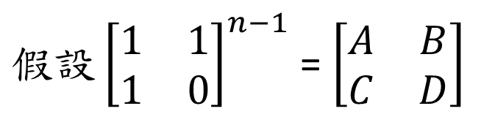
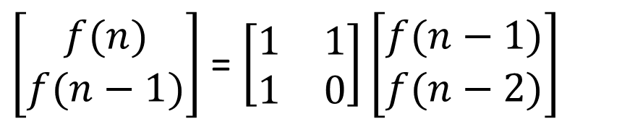
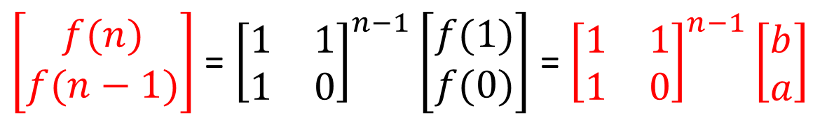
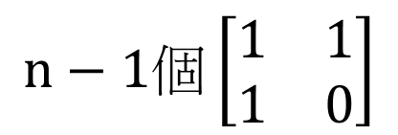
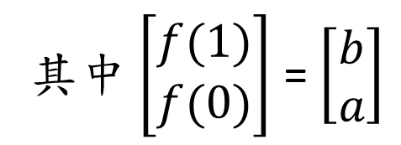
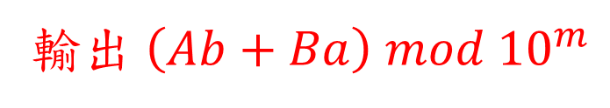
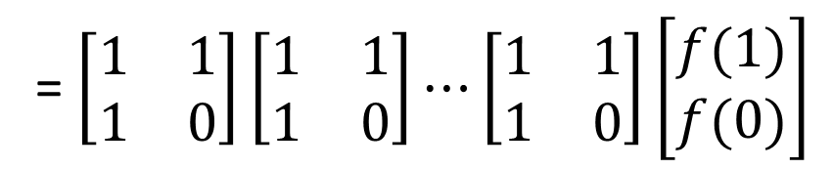

f(0)=a, f(1)=b, f(n)=f(n-1)+f(n-2), n>1
$\left[\begin{matrix}f(n) \\ f(n−1)\end{matrix}\right]$ = $\left[\begin{matrix}1 & 1 \\ 1 & 0\end{matrix}\right]\left[\begin{matrix}f(n−1) \\ f(n−2)\end{matrix}\right]$
= $\left[\begin{matrix}1 & 1 \\ 1 & 0\end{matrix}\right](\left[\begin{matrix}1 & 1 \\ 1 & 0\end{matrix}\right]\left[\begin{matrix}f(n−2) \\ f(n−3)\end{matrix}\right]$)
= $\left[\begin{matrix}1 & 1 \\ 1 & 0\end{matrix}\right]\left[\begin{matrix}1 & 1 \\ 1 & 0\end{matrix}\right]⋯\left[\begin{matrix}1 & 1 \\ 1 & 0\end{matrix}\right]\left[\begin{matrix}f(1) \\ f(0)\end{matrix}\right]$
其中$\left[\begin{matrix}f(1) \\ f(0)\end{matrix}\right]$ = $\left[\begin{matrix}b \\ a\end{matrix}\right]$
$$n−1個\left[\begin{matrix}1 & 1 \\ 1 & 0\end{matrix}\right]$$
$\left[\begin{matrix}f(n) \\ f(n−1)\end{matrix}\right]$ = ${\left[\begin{matrix}1 & 1 \\ 1 & 0\end{matrix}\right]}^{n−1}\left[\begin{matrix}f(1) \\ f(0)\end{matrix}\right]$ = ${\left[\begin{matrix}1 & 1 \\ 1 & 0\end{matrix}\right]}^{n−1}\left[\begin{matrix}b \\ a\end{matrix}\right]$
$假設{\left[\begin{matrix}1 & 1 \\ 1 & 0\end{matrix}\right]}^{n−1}$ = $\left[\begin{matrix}A & B \\ C & D\end{matrix}\right]$
$\left[\begin{matrix}f(n) \\ f(n−1)\end{matrix}\right]$ = $\left[\begin{matrix}A & B \\ C & D\end{matrix}\right]\left[\begin{matrix}b \\ a\end{matrix}\right]$
$$f\left(n\right)= Ab+Ba$$
輸出 $\left(Ab+Ba\right) mod {10}^{m}$

Slide 8
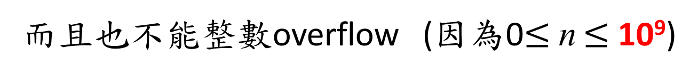
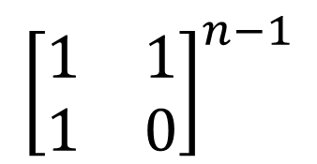
重點變成:
$${\left[\begin{matrix}1 & 1 \\ 1 & 0\end{matrix}\right]}^{n−1}$$
有效率的計算
而且也不能整數overflow (因為0$≤$n $≤$10⁹)

Slide 9

如何不發生integer overflow
觀察:
由於計算矩陣相乘過程中, 都是做乘法, 加法運算, 到最後才做 mod 找餘數動作。
等同在矩陣相乘過程中只要一做加法結果,立即做mod運算, 把數字壓低, 躲避integer overflow風險。
根據此點來執行${\left[\begin{matrix}1 & 1 \\ 1 & 0\end{matrix}\right]}^{n−1}$計算

Slide 10
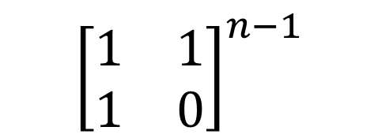
$${\left[\begin{matrix}1 & 1 \\ 1 & 0\end{matrix}\right]}^{n−1}$$
如何有效率的計算
考慮廣義的矩陣冪次方計算

Slide 11
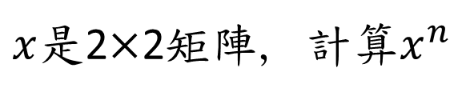
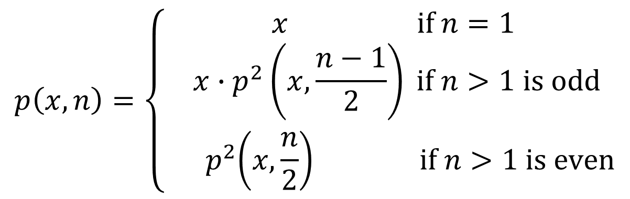
矩陣冪次方計算(recursive 方法)
$x$是2$×$2矩陣, 計算$x^{n}$
$$p\left(x,n\right)=\left\{ \begin{aligned}x if n=1 \\ x∙p^{2}\left(x,\frac{n−1}{2}\right) if n>1 is odd \\ { p}^{2}\left(x,\frac{n}{2}\right) if n>1 is even\end{aligned}\right.$$
矩陣相乘次數: O(log n)

Slide 12
Recursive Squaring Method
Algorithm Power(x, n):
Input: A 2x2 matrix x and integer n
Output: The matrix x^{n}
if n = 1 then
return x
if n>1 is odd then
y = Power(x, (n - 1)/ 2)
return x · y ·y
else
y = Power(x, n/ 2)
return y · y

Slide 13
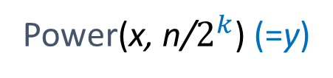
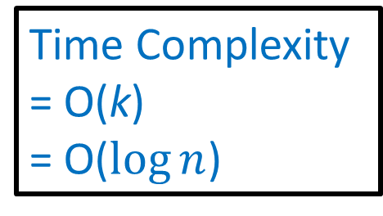
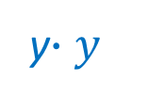
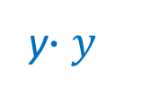

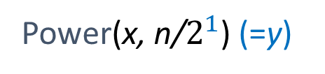
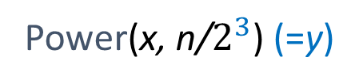
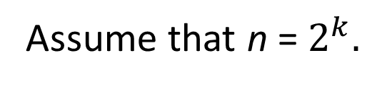
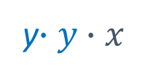

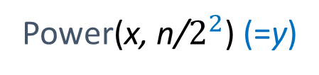
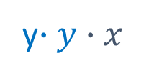

Analysis of Power(x,n)
If n is even
Power(x, n)
depth
Power(x, n/$2^{1}$) (=y)
y$∙y$
1
Power(x, n/$2^{2}$) (=y)
y$∙y∙x$
2
y$∙y$
3
Assume that n = $2^{k}.$
Power(x, n/$2^{3}$) (=y)
$$k= \log_{2}{n}$$
$$⋮$$
$$⋮$$
Time Complexity
= O(k)
= O($\log{n}$)
Power(x, n/$2^{k}$) (=y)
y$∙y∙x$
k

Slide 14
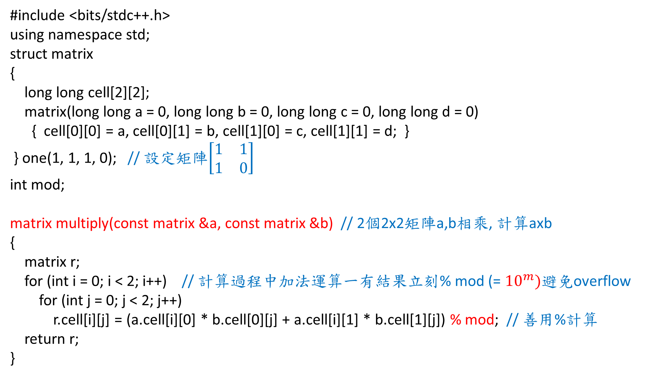
#include <bits/stdc++.h>
using namespace std;
struct matrix
{
long long cell[2][2];
matrix(long long a = 0, long long b = 0, long long c = 0, long long d = 0)
{ cell[0][0] = a, cell[0][1] = b, cell[1][0] = c, cell[1][1] = d; }
} one(1, 1, 1, 0); // 設定矩陣$\left[\begin{matrix}1 & 1 \\ 1 & 0\end{matrix}\right]$
int mod;
matrix multiply(const matrix &a, const matrix &b) // 2個2x2矩陣a,b相乘, 計算axb
{
matrix r;
for (int i = 0; i < 2; i++) // 計算過程中加法運算一有結果立刻% mod (= ${10}^{m})$避免overflow
for (int j = 0; j < 2; j++)
r.cell[i][j] = (a.cell[i][0] * b.cell[0][j] + a.cell[i][1] * b.cell[1][j]) % mod; // 善用%計算
return r;
}
UVa 10689 Code (1/3)

Slide 15
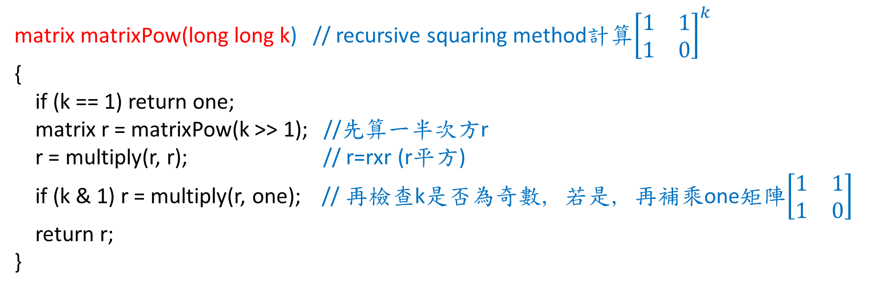
UVa 10689 Code (2/3)
matrix matrixPow(long long k) // recursive squaring method計算${\left[\begin{matrix}1 & 1 \\ 1 & 0\end{matrix}\right]}^{k}$
{
if (k == 1) return one;
matrix r = matrixPow(k >> 1); //先算一半次方r
r = multiply(r, r); // r=rxr (r平方)
if (k & 1) r = multiply(r, one); // 再檢查k是否為奇數, 若是, 再補乘one矩陣$\left[\begin{matrix}1 & 1 \\ 1 & 0\end{matrix}\right]$
return r;
}

Slide 16
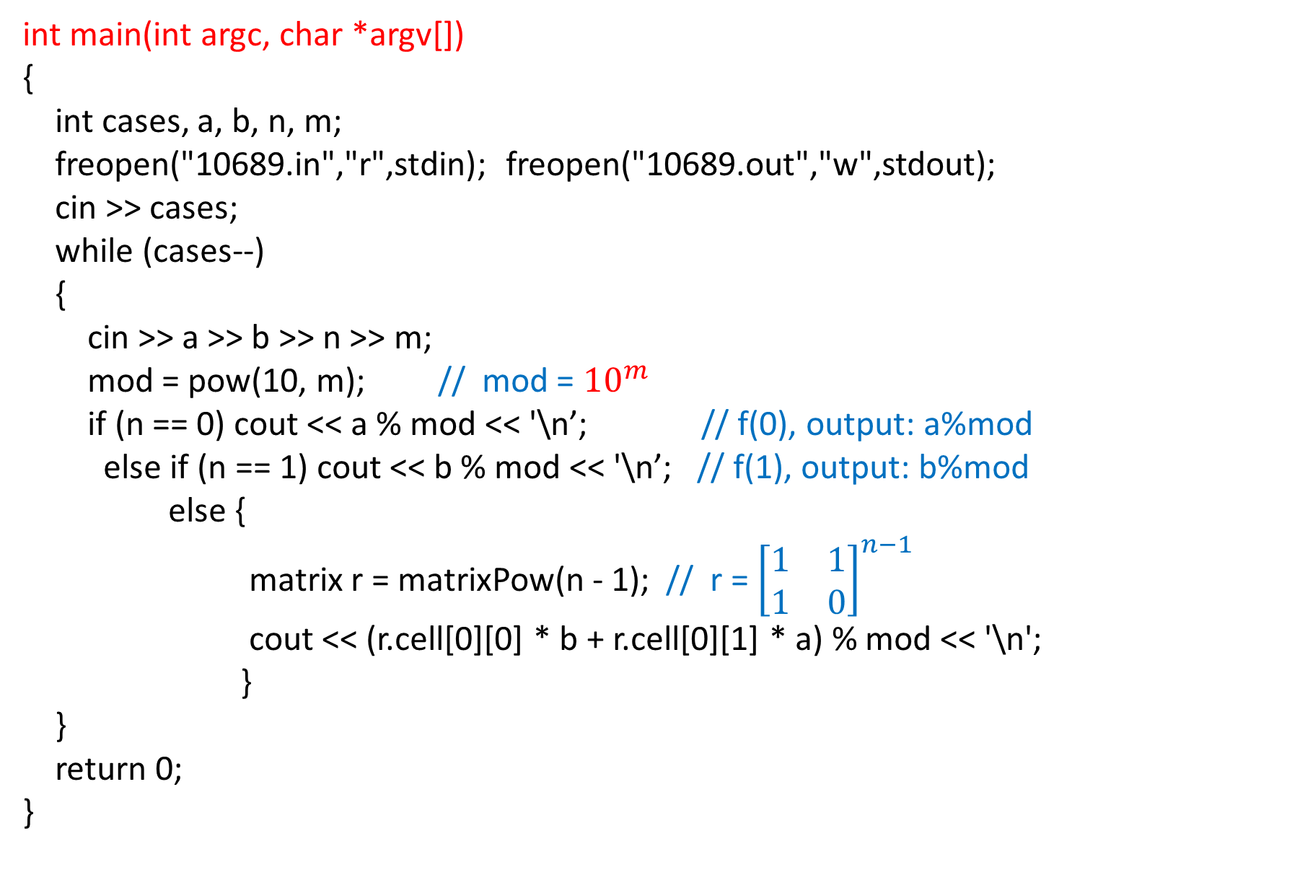
int main(int argc, char *argv[])
{
int cases, a, b, n, m;
freopen("10689.in","r",stdin); freopen("10689.out","w",stdout);
cin >> cases;
while (cases--)
{
cin >> a >> b >> n >> m;
mod = pow(10, m); // mod = ${10}^{m}$
if (n == 0) cout << a % mod << '\n’; // f(0), output: a%mod
else if (n == 1) cout << b % mod << '\n’; // f(1), output: b%mod
else {
matrix r = matrixPow(n - 1); // r = ${\left[\begin{matrix}1 & 1 \\ 1 & 0\end{matrix}\right]}^{n−1}$
cout << (r.cell[0][0] * b + r.cell[0][1] * a) % mod << '\n';
}
}
return 0;
}
UVa 10689 Code (3/3)

